Slide 1
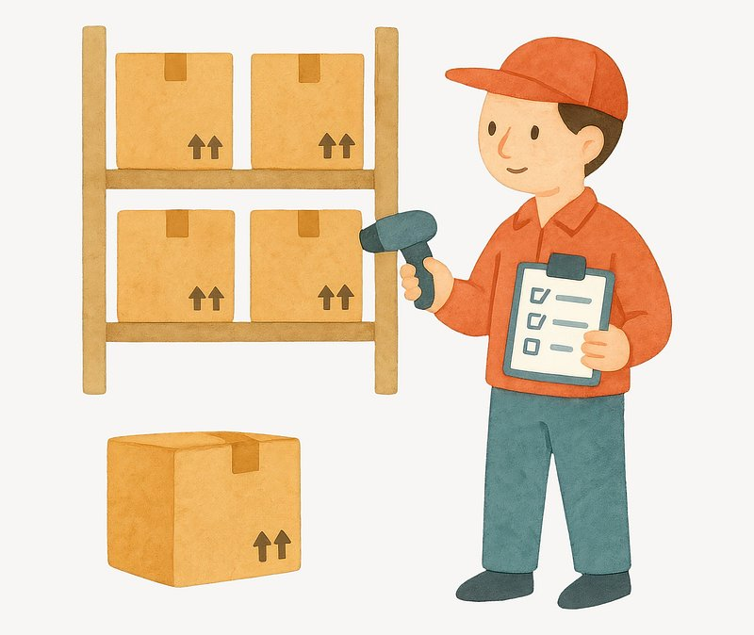
Inventory management & control
By
Rohini

Slide 2
Problem statement
this inventory is currently facing a problem about limitation in the warehouse and its expensive.
They increase in storage costs and insurance.
Inventories are classified as fast moving, slow moving, non-moving products.
To improve inventory efficiency and supply chain management.
Which categories are selling quickly, which are remaining unsold and overstocked, what are the categories are facing frequent shortages are the queries we need to be clearly explained.

Slide 3
Solution
Here the explanations are described into 3 analystics
Inventory analysis
Stock movement analysis
Sales analysis,
Alerts/ actions.

Slide 4
inventory analysis
This analysis is for what are the essentials we need to be monitored.
Category wise current stock and safety stock.
Month wise holding cost.
These should be looked after every months to move forward for the next step.

Slide 5
Stock movement
This analysis is also important from avoiding overstocking and understocking.
Category wise stockouts for replenishment decisions.
Replenishment cycles is about how? By calculating lead time days and daily demand.

Slide 6
Sales analysis
The main problem of the inventory is in sales and what are the demand.
Compare the lost sales value with forecasted demand for next upcoming days.
Monitor the service level like comparing month wise order fulfillment.
These steps can prevent inventories to get overstocked in the warehouse.

Slide 7

Integrated view
Another integrated view is creating alerts for overstocking and shortages.
This can be done by comparing total orders last month with demand and forecasted demand with current stock.
If it is in overstocked range, inventories can be returned or sold for discounts and if it is in understock range, this can be replenished as soon as possible.
This Photo by Unknown Author is licensed under CC BY-NC-ND

Slide 8

solutions
Daily demand is consistently high across categories, with automotive leading (16,757 unts/day). In stock movement.
In inventory, safety stock ---all categories—low--- while total stock level----high in units. Apparel has the lowest sstk ----indicating higher risk.
Automotive shows the highest lost sales value ----denoting fulfillment issues.
Overstocking warning is indicated by stock levels(828,463) are higher than forecasted demand (486,000) app. So , no low stock.
Average layout efficiency is 60% (moderate).
Service levels vary, fulfillment rates are in not good.

Slide 9
conclusion
Balance Inventory
  Overstocking is evident: stock levels exceed forecasted demand by ~70%.
  Implement dynamic reorder policies to align stock with demand forecasts.
Reduce Stockouts
  Automotive face the highest stockouts.
  Increase safety stock for these categories, especially during peak demand months.
Improve Fulfillment Rates
  Lost sales value is high due to unmet demand.

Slide 10
Continue…
  Enhance supplier reliability and shorten lead times to improve order fulfillment.
Optimize Costs
  Holding costs are rising in Q1–Q2.
  Apply ABC analysis to prioritize high-value items and reduce excess holding.
Warehouse Efficiency
  Layout efficiency score (0.60) suggests room for improvement.
  Reorganize warehouse layout and adopt automation tools for faster picking.

